Slide 1


SOCIAL BUZZ TOP 5 CONTENT ANALYSIS

Slide 2


Today's agenda
Project recap
Problem
The Analytics team
Process
Insights
Summary
Conclusion

Slide 3


s
Social Buzz is a social media industry that focuses on content creation and has reached over 500 million active users each month. Due to their rapid growth and digital nature of their core product, data maintenance and management are very expensive and there’s a need to adapt quickly to its global scale.
Hence, Accenture has begun a 3 month POC focusing on these tasks:
An audit of Social Buzz’s big data practice
Recommendations for a successful IPO
Analysis to find Social Buzz’s top 5 most popular content categories
Project Recap

Slide 4


Problem
Understand preference among 500million active users
Analyze:
100,000 post per day
9,215,000 content quarterly
36,500,000 content per year
Analysis to highlight Social Buzz’s top 5 categories with the largest aggregate popularity

Slide 5



Andrew Fleming
Chief Technical Architect
The Analytics team
Marcus Rompton
Senior Principle
Tiletile Toheebat
Data Analyst

Slide 6

Process
1
Data Collection and Understanding
2
Data Cleaning
3
Data Modelling
4
Data Analysis
5
Uncover Insights

Slide 7


Content Category | Number of Reaction
Animals | 74965
science | 71168
healthy eating | 69339
technology | 68738
food | 66676
culture | 66579
travel | 64880
cooking | 64756
soccer | 57783
education | 57436
fitness | 55323
Studying | 54269
dogs | 52511
tennis | 50339
veganism | 49619
public speaking | 49264
Grand Total | 973645
Insights
In this Analysis, there are 16 Unique Content categories, 4 Content type, 15 reactions and 3 Sentiments.
Each categories of content has their reaction score and the sum of the reaction equals 973,645 reactions with Animals, Science, Healthy eating, Technology and Food as the Top 5 categories of content with the largest aggregate popularity.

Slide 8
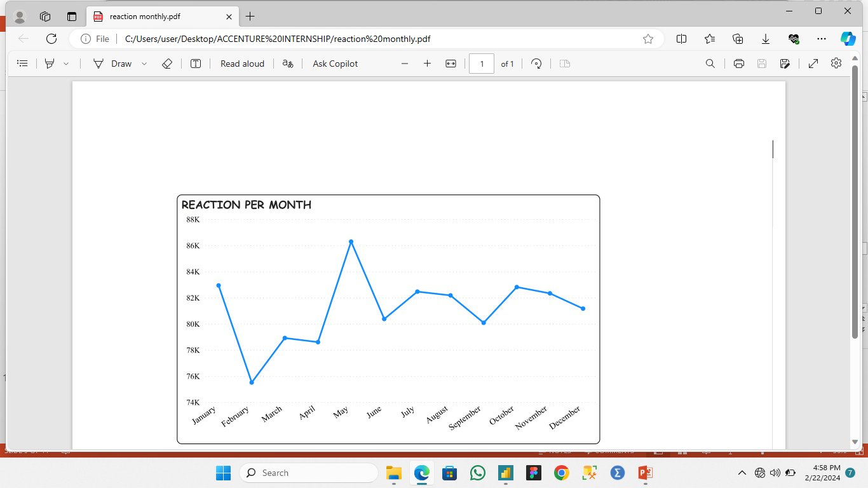
The month with the highest post is May with 86,293 reactions in which 73,191 reactions are positive, 7,840 neutral reactions and 5,262 negative reactions.

Slide 9
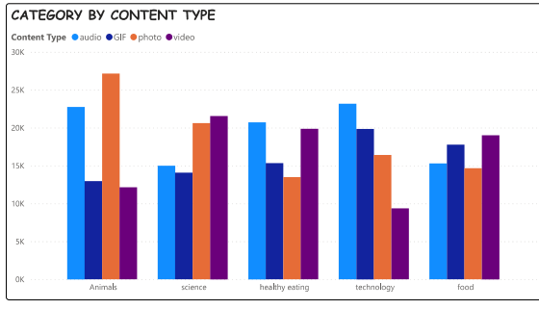
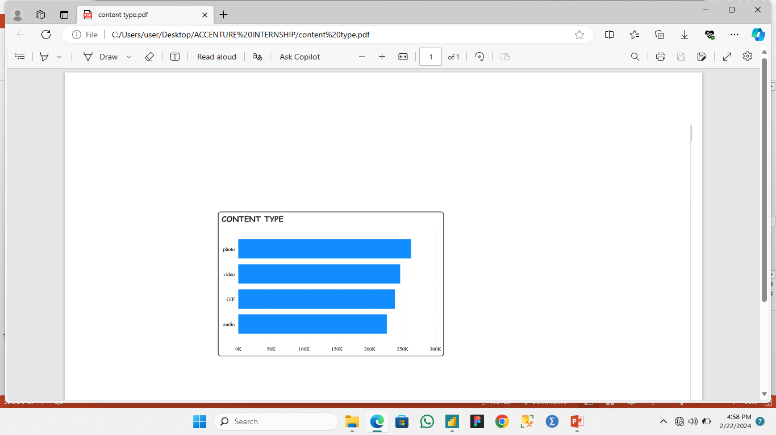
In the top 5 category, Photo content has the highest reaction score of 262,838 while Audio has least score of 226,127.
Animal post in picture format receives more popularity than other content format.
Post about technology and healthy eating in audio form gains more audience than other format.
Science and food related content in video format receives more engagement than others.
GIF content type is more prominent with technology related post.

Slide 10


FINDINGS
The top 5 most popular content are Animals, Science, healthy easting technology and food.
Sentiment analysis indicates that content related to these topics generates positive reactions from audience and each content has its preferred format.
Summary
RECOMMENDATION
Its recommended to tailor each content strategy to leverage preferred format within each topics and also explore strategic partnership and collaboration within this distinct market segment.
Create an advertising budget to promote content related to these popular categories, targeting demographics interested in animals, science, healthy eating, technology and food.

Slide 11
In conclusion, leveraging the popularity and positive sentiment surrounding animals, science, healthy eating, technology, and food, along with tailored content formats and strategic partnerships will present a significant opportunity for the industry to enhance engagement and drive growth on the platform.
CONCLUSION

Slide 12

Thank you!
ANY QUESTIONS?

